Slide 1
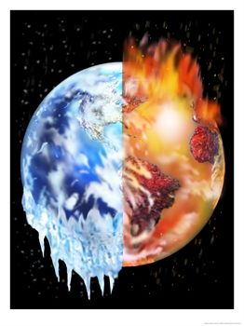
Global Warming

Slide 2
Global Warming
Why Global?
It affects the entire planet
Warming
Rise in the average temperature

Slide 3
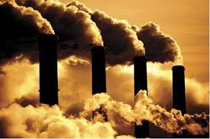
Global Warming is mostly caused by:
POLLUTION caused by human activities
Industry
Transportation
Chemical Substances used in agriculture
SMOG (smoke+fog)
Greenhouse gases

Slide 4
POLLUTION CAUSES
- Increase of atmospheric temperature
- Continents and atmosphere warming
- Ocean warming
- Ice melting
Many of the observed changes since the 1950s are unprecedented

Slide 5
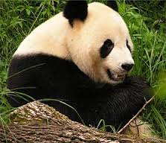
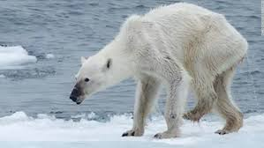
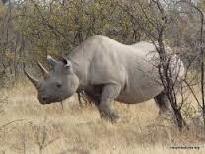
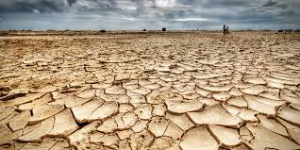
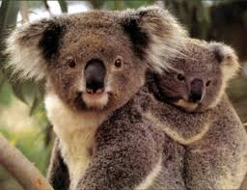
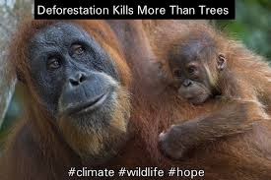
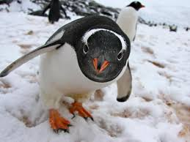
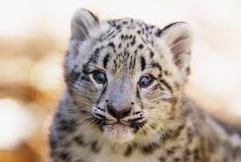
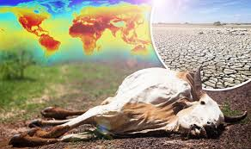
Future Changes
Polar Bear
Panda
Rhinoceros
- Warming of the global temperature
- Rising of sea levels
- Changes in precipitation
- Desert expansion
- Extreme weather events (heat waves, droughts, heavy rainfall, flooding)
- Retreat of glaciers and permafrost
- Species extinction
Snow leopard
Koala
Orangutan
Penguin

Slide 6
What can we do?
http://www.50waystohelp.com/

Slide 7
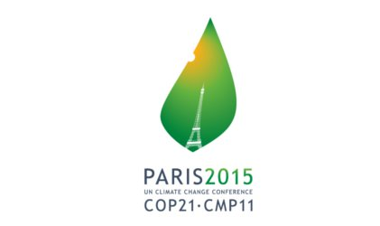
Paris 2015 United Nations Climate Change Conference
What can the world do?
https://www.youtube.com/watch?v=0n6hleA7M6o

